Slide 1
how can we effectively build metro stations?
-Shlok Agarwalla

Slide 2
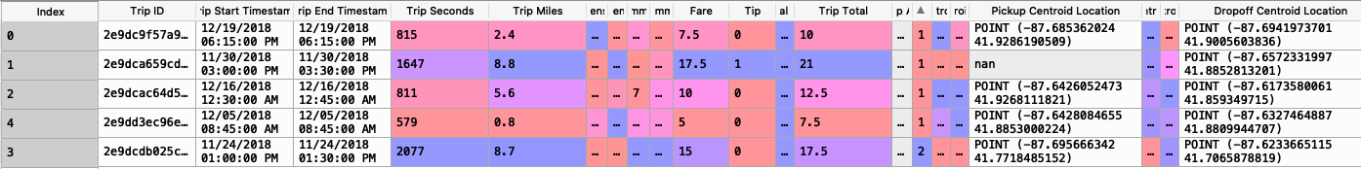
Chicago Taxi Data: data.cityofchicago.org/
Important Columns: Trip Start location, Trip End location.

Slide 3
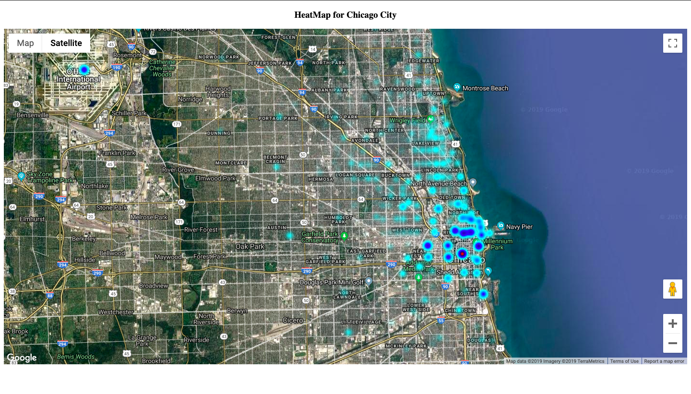

Slide 4
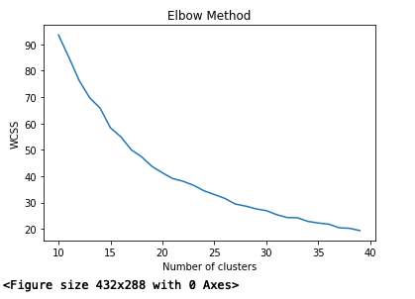
how many metro stations should we build?
WCSS
Graph.

Slide 5
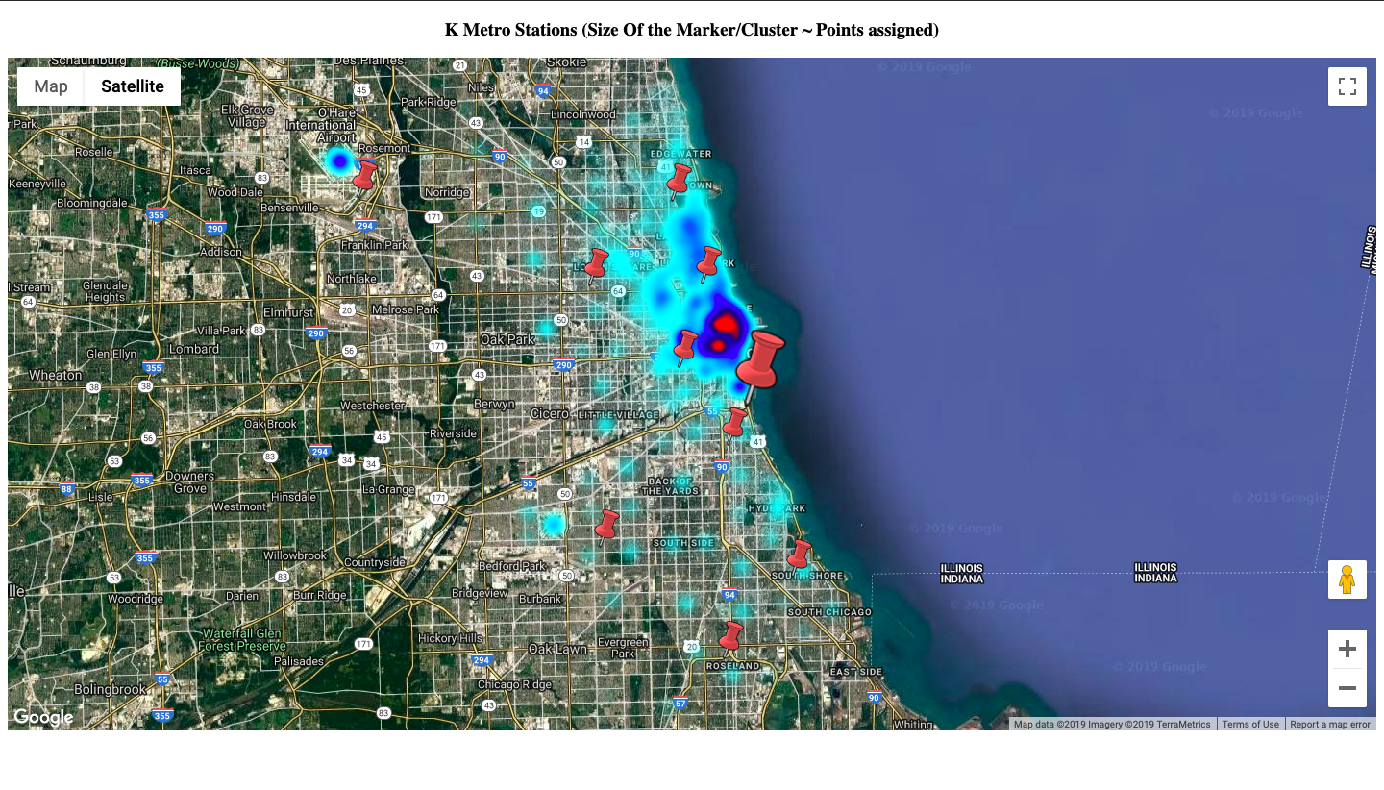

Slide 6
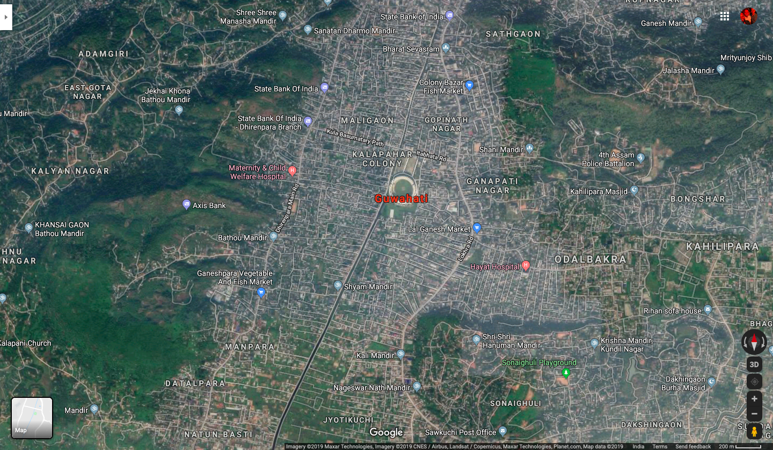

Slide 7
thank you!

